Slide 1
Predicting the Best Neighborhood for a Mexican Restaurant in Toronto. Victor Gbadamosi January 06, 2021.

Slide 2
Problem Statement
What is the best location to open up a Mexican restaurant? As time goes on, the city's population of Toronto that is currently around 3.5 million will probably increase to about 7 million in the space of 50 years. So, in the bid to develop a Mexican restaurant, which will require a lot of money and hard work to set up, which of the neighborhoods in Downtown Toronto would represent the best option?

Slide 3
Data Sources
The dataset that will be used is available on the Wikipedia page: https://en.wikipedia.org/wiki/List_of_postal_codes_of_Canada:_M. This dataset describes Toronto neighbourhood details alongside their postal codes. As discussed earlier, the focus of the project will be the Downtown Toronto neighborhoods which will be extracted and analyzed. The coordinates of the neighborhoods were also gotten from https://cocl.us/Geospatial_data.

Slide 4
Exploratory data analysis
Table 3.1: Preview of the list of the postal codes before it was cleaned.
 | Postal Code | Borough | Neighborhood
0 | M1A | Not assigned | Not assigned
1 | M2A | Not assigned | Not assigned
2 | M3A | North York | Parkwoods
3 | M4A | North York | Victoria Village
4 | M5A | Downtown Toronto | Regent Park, Harbourfront

Slide 5
Exploratory data analysis
Table 3.2: Preview of the list of postal codes after it was cleaned.
 | Postal Code | Borough | Neighborhood
0 | M1B | Scarborough | Malvern, Rouge
1 | M1C | Scarborough | Rouge Hill, Port Union, Highland Creek
2 | M1E | Scarborough | Guildwood, Morningside, West Hill
3 | M1G | Scarborough | Woburn
4 | M1H | Scarborough | Cedarbrae

Slide 6
Exploratory data analysis
Table 3.3: Merged list of postal codes with their coordinates.
 | PostalCode | Borough | Neighborhood | Latitude | Longitude
0 | M1B | Scarborough | Malvern, Rouge | 43.806686 | -79.194353
1 | M1C | Scarborough | Rouge Hill, Port Union, Highland Creek | 43.784535 | -79.160497
2 | M1E | Scarborough | Guildwood, Morningside, West Hill | 43.763573 | -79.188711
3 | M1G | Scarborough | Woburn | 43.770992 | -79.216917
4 | M1H | Scarborough | Cedarbrae | 43.773136 | -79.239476

Slide 7
Exploratory data analysis
Table 3.4: Preview of the Downtown Toronto borough.
 | PostalCode | Borough | Neighborhood | Latitude | Longitude
0 | M4W | Downtown Toronto | Rosedale | 43.679563 | -79.377529
1 | M4X | Downtown Toronto | St. James Town, Cabbagetown | 43.667967 | -79.367675
2 | M4Y | Downtown Toronto | Church and Wellesley | 43.665860 | -79.383160
3 | M5A | Downtown Toronto | Regent Park, Harbourfront | 43.654260 | -79.360636
4 | M5B | Downtown Toronto | Garden District, Ryerson | 43.657162 | -79.378937

Slide 8
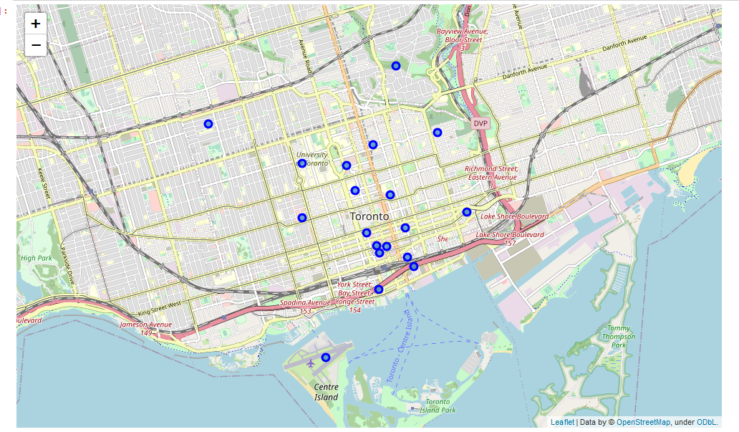
Exploratory data analysis
Fig 3.1: Map of Downtown Toronto.

Slide 9
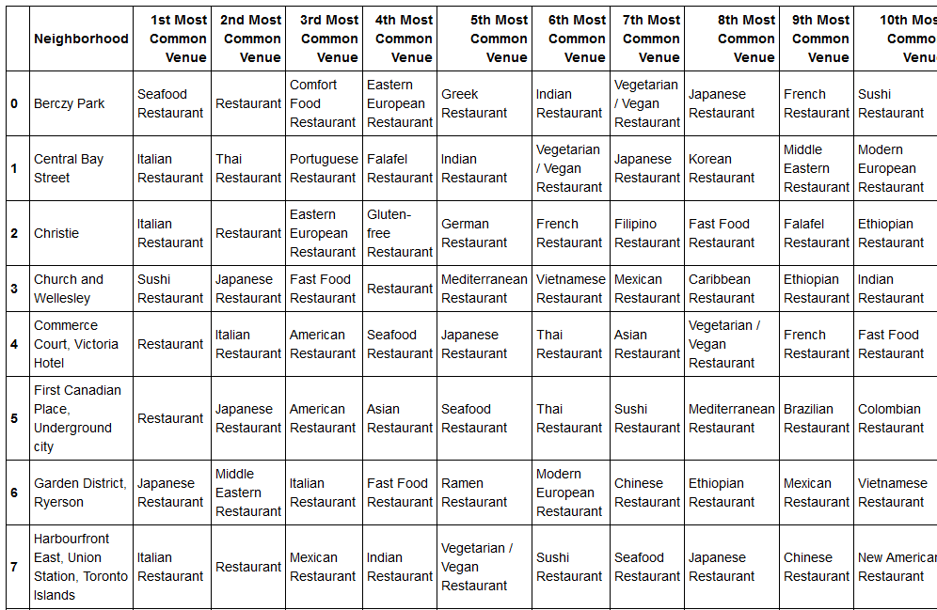
Results
Table 4.1: Preview of the dataframe before clustering.

Slide 10
Observations
Sixteen (16) neighbourhoods were used to test and the following observations were made.
Most neighborhoods have Italian restaurants.
Italian restaurants were one of the top three (3) venues that were visited for neighbourhoods that had them, meaning so many people enjoyed their cuisines.
Only five (5) neighborhoods have Mexican restaurants, meaning there are not so many set-ups there.
None of the Mexican restaurant falls under the 1st most common venue.

Slide 11
Recommendations
Since the client is looking for a best location to set up a Mexican restaurant, and only three (3) neighborhoods are without Italian and Mexican restaurants, the client would be advised to set up where people will always be present to hangouts. Therefore, the best location will be the Berczy Park to set up the Mexican restaurants.

Slide 12
Conclusions
I was able to achieve the desired purpose of the analysis by giving the client the best location to set up his Mexican restaurant which is the Berczy Park.

